Slide 1


Interoperability Simulator for Data Spaces
Aldi Doanta Kurnia
Master Computer Science – Software Technology
Graduation Committee:
dr. L. Ferreira Pires
dr. J.L. Rebelo Moreira
dr. M.A. Lopuhaä - Zwakenberg
D.R. Firdausy, EngD
Faculty of Electrical Engineering, Mathematics and Computer Science (EEMCS)

Slide 2
Research Approach
Source: Wieringa, R. J. (2014). Design science methodology: For Information Systems and Software Engineering

Slide 3

Part 1 Problem Investigation

Slide 4
Definitions of Interoperability
“Ability of multiple systems or components to exchange information and to use the exchanged information”
—IEEE Standard Computer Dictionary
“Ability of multiple software components to cooperate despite having different languages, interfaces, and execution platforms”
—Peter Wegner

Slide 5
Interoperability in the IT Industry
Historically, organizations worked in silos. They don’t use data outside of their organizations.
Since the advent of the internet, data exchange process has become more technically feasible. Organizations started to realize the benefits of data sharing.
However, data interoperability is still hard to achieve.
Example causes: different file formats, different data schemas, different meaning of data instances.

Slide 6

Why creating a new standard is not always the perfect solution
Source: xkcd: Standards https://xkcd.com/927/

Slide 7
If people will always create new standards…
…can we at least bridge the differences? preferably in a data-sharing environment (which requires another new standard)

Slide 8
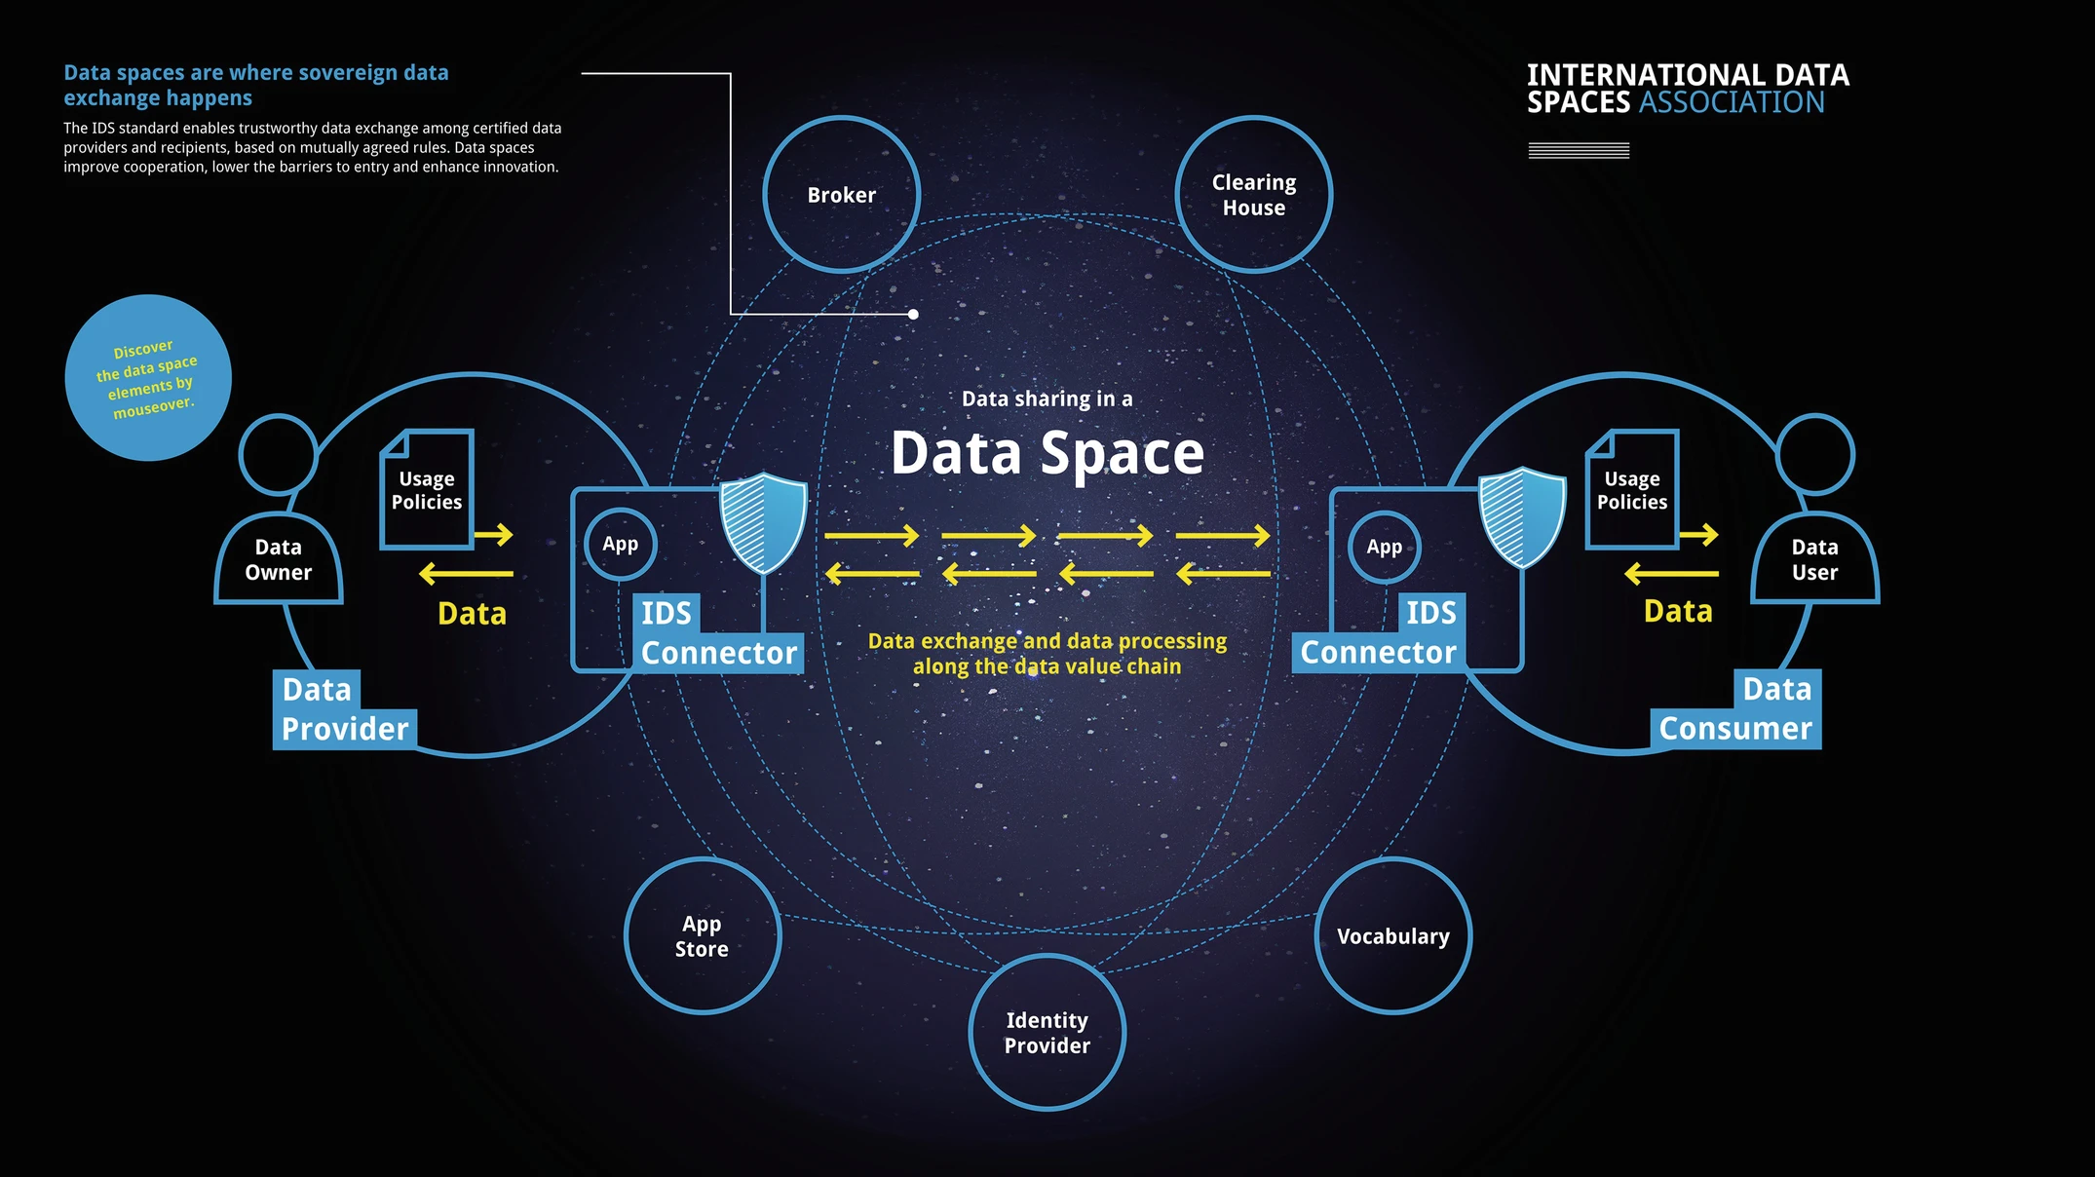

Slide 9
Interoperability in IDS
IDS only provides an ecosystem to enable data sharing between the data space participants.
IDS does not provide a way to measure information gap in data schemas etc.
As a data marketplace, IDS does not provide a way to calculate the total costs to access commercial data.
Proposed solution: Interoperability Simulator

Slide 10
Research Questions
“How can an Interoperability Simulator help the interacting organizations measure costs of resolving the information gap in a data interoperability scenario in data spaces?”
Research Sub-questions (paraphrased)
What attributes can be gathered?
How can those attributes be used to assess the information gap?
How to report the information gap assessment results?

Slide 11
Part 2 Treatment Design

Slide 12
Design Artifacts
Definition of Interoperability Scenario
Software Requirements
Reference Architecture with two viewpoints
Concrete Architecture
Business Processes

Slide 13
Interoperability Scenario

Slide 14
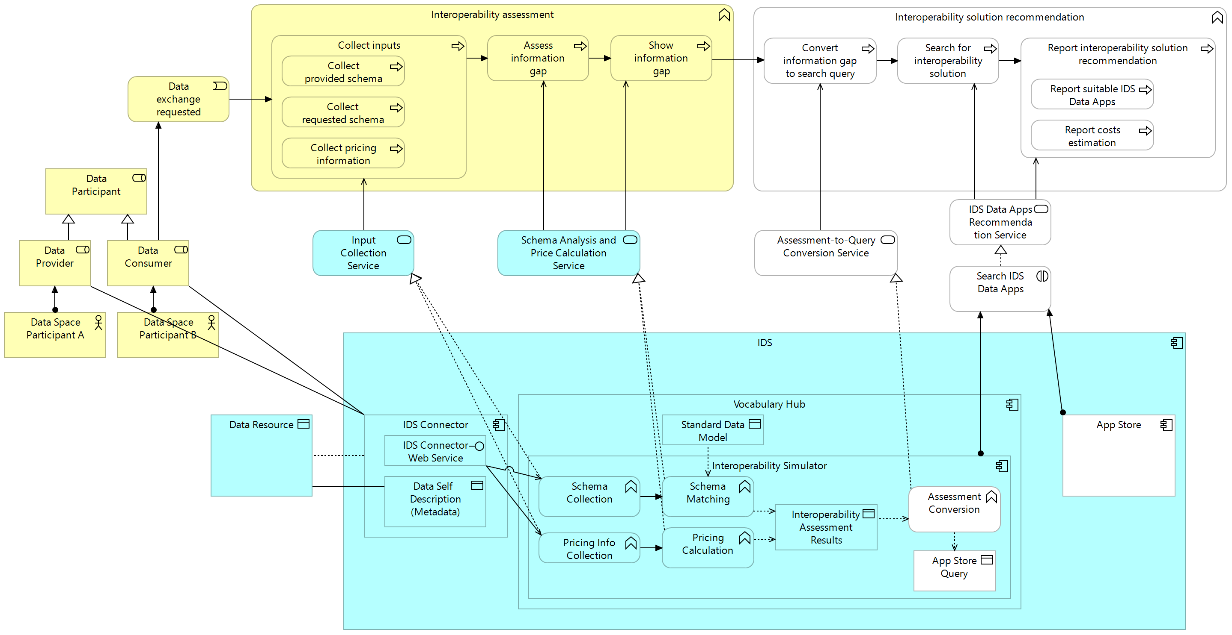
Reference Architecture
Application Usage View

Slide 15
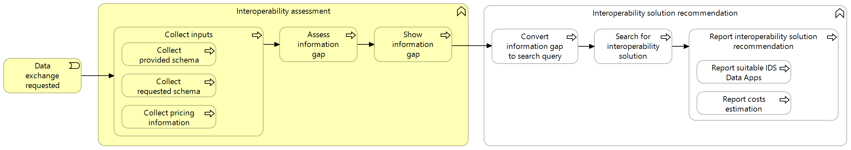
Reference Architecture
Application Usage View – Business Layer

Slide 16
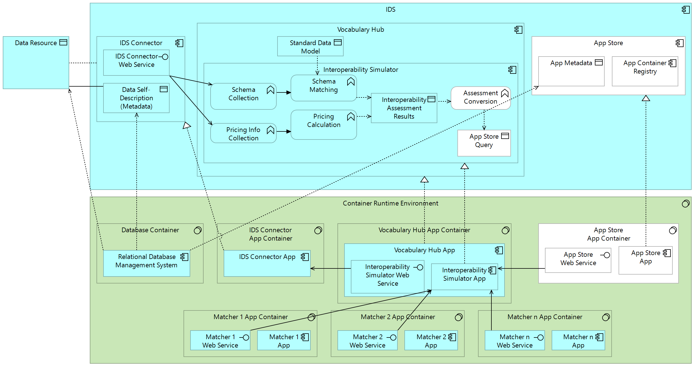
Reference Architecture
Implementation and Deployment View

Slide 17
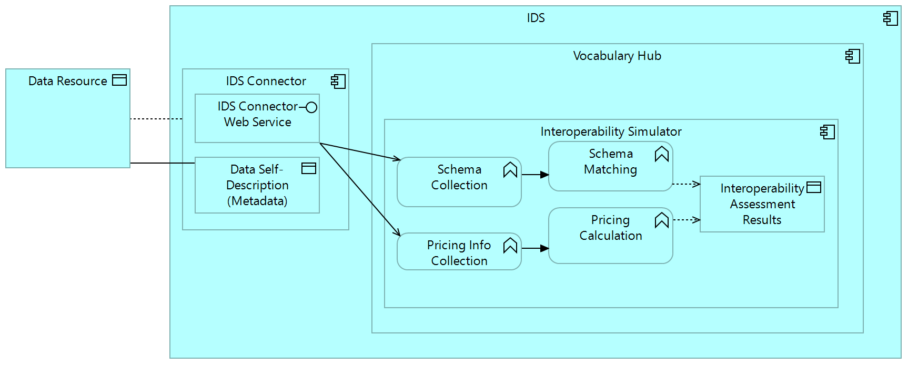
Reference Architecture
Implementation and Deployment View – Application Layer

Slide 18
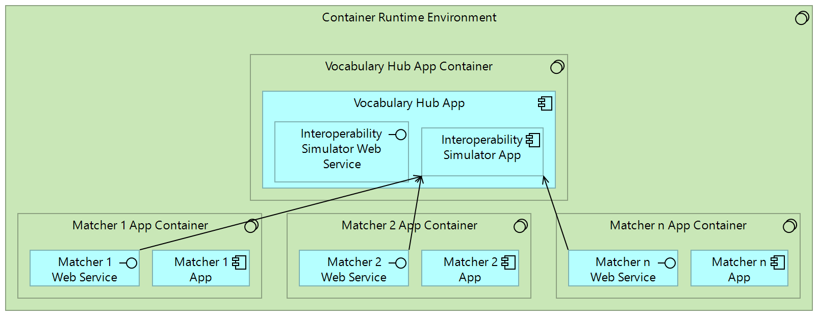
Reference Architecture
Implementation and Deployment View – Interoperability Simulator and the Matchers

Slide 19
Decoupled Matchers Design
Pros
Cons
+ Gives more flexibility to the implementation phase
+ Adding a new Matcher doesn’t affect the implementation of the Interoperability Simulator and the existing Matchers
- Adds more complexity to the deployment phase
- Adds more latency to the response time of the Interoperability Simulator

Slide 20
Part 3 Treatment Validation

Slide 21
Prototype Development
Implementation of the Interoperability Simulator
Implementation of the IDS Connector

Slide 22
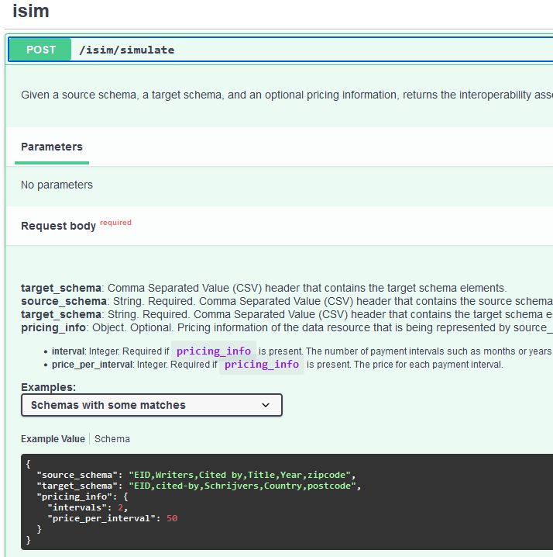
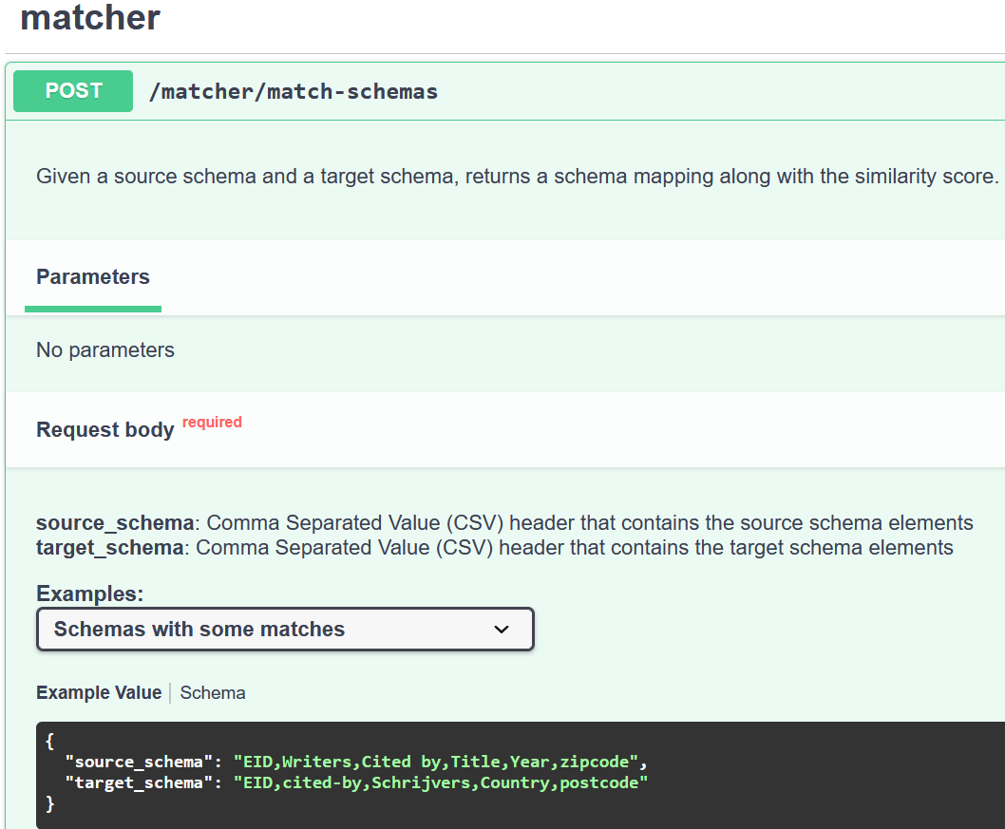
Implementation of the Interoperability Simulator

Slide 23
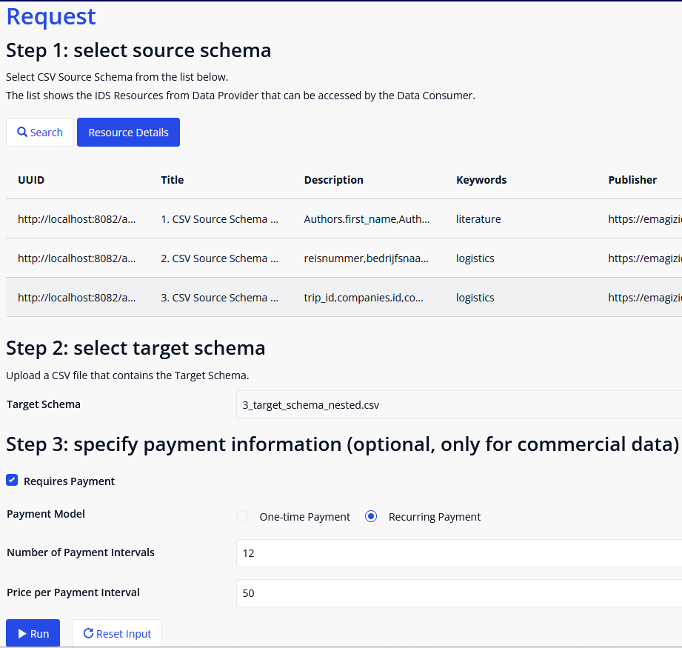
Implementation of the IDS Connector
Inputs of an interoperability assessment process
Source Schema |  | Target Schema
trip_id |  | id
companies.id |  | status
companies.name |  | actors.entity.id
companies.description |  | actors.entity.name
companies.role |  | actors.roles
status |  | actors.associationType

Slide 24
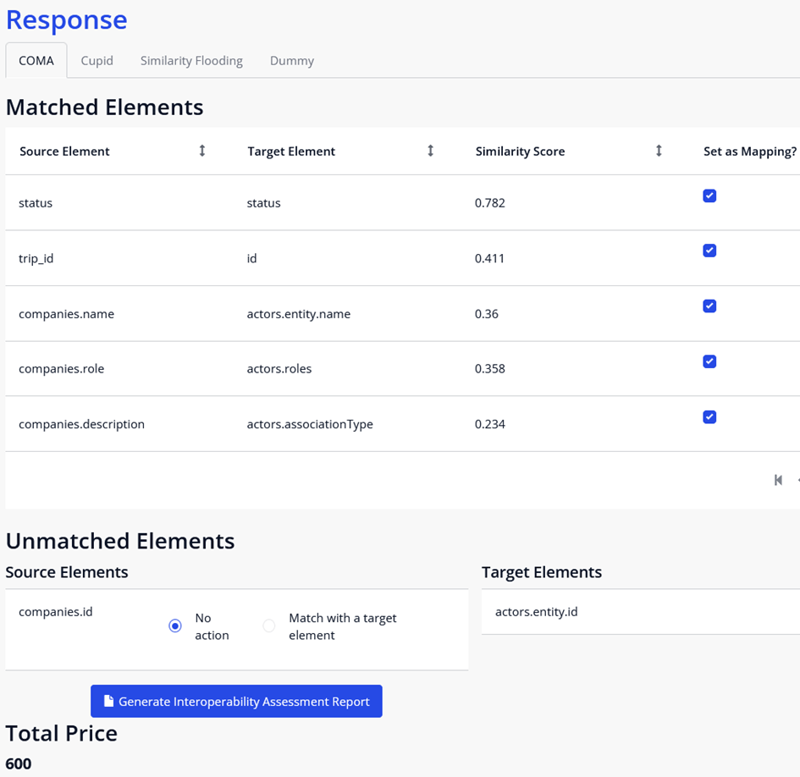
Implementation of the IDS Connector
Interoperability assessment results

Slide 25
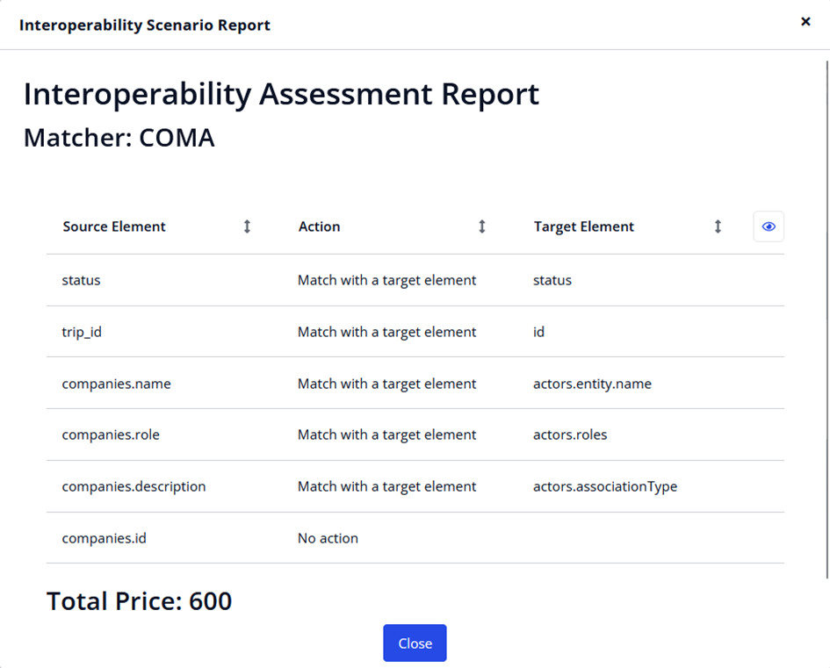
Implementation of the IDS Connector
Interoperability assessment report

Slide 26


Prototype Validation using Expert Opinion
Researcher and PhD candidate, IEBIS
Two Expert Services
Senior Business Consultant, Data Ecosystem
Scientist Innovator
Senior Advisor, Data Sharing and Interoperability

Slide 27
Key Feedback Points
Payment information should be part of the metadata of the source schema. In other words, payment information should be provided directly by the Data Provider.
Syntactic metadata (e.g., data types, value constraints) can be used to improve the schema-matching performance.
The Interoperability Simulator should use context-aware capabilities such as data types or domain-specific context from IDS Vocabulary Hub.
The Pricing Calculation function should be implemented as a separate function that works at the business/legal interoperability level.

Slide 28
Conclusions
Interoperability Simulator can help measure costs of resolving the information gap using three inputs: (1) the provided schema (source schema) from the Data Provider, (2) the requested schema (target schema) from the Data Consumer, and (3) the optional pricing information for commercial data.
The Schema Matching function uses the input schemas to perform schema matching operations using multiple Matchers. Each Matcher is deployed as a separate container from the Interoperability Simulator’s container.
The Pricing Calculation function uses the pricing information provided by the Data Consumer to calculate the total price for the data resource. However, this function is more suitable to solve legal and business interoperability issues than syntactic interoperability issues.
The interoperability assessment results can be summarized into a single interoperability assessment report, presenting the schema matching results and the action that needs to be performed for each source element.

Slide 29
Topics for Future Work
Realizing the “interoperability solution recommendation” business function (the white components of the reference architecture).
Using another schema format that supports metadata e.g., JSON schema or XSD.
Using Interoperability Simulator to solve problems at the semantic interoperability level.

Slide 30
Thank You
Questions and feedback would be appreciated!
Credits:
Presentation template by Slidesgo
Background images by Freepik

